Slide 1
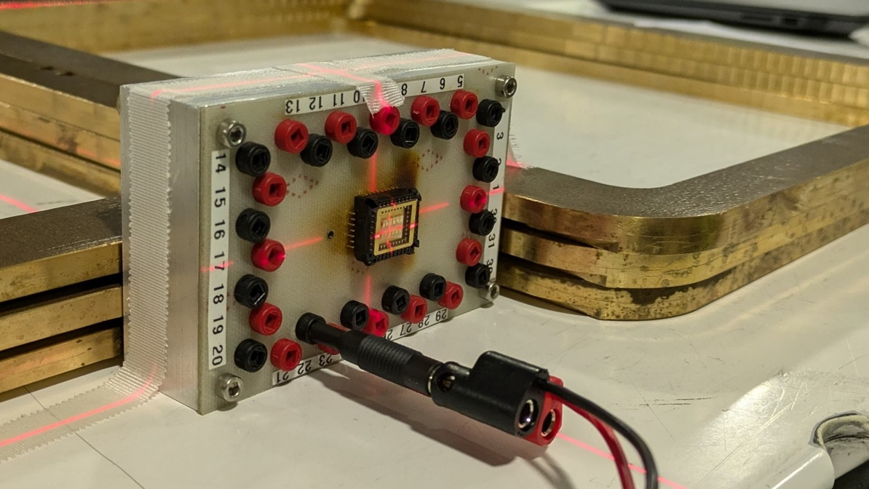
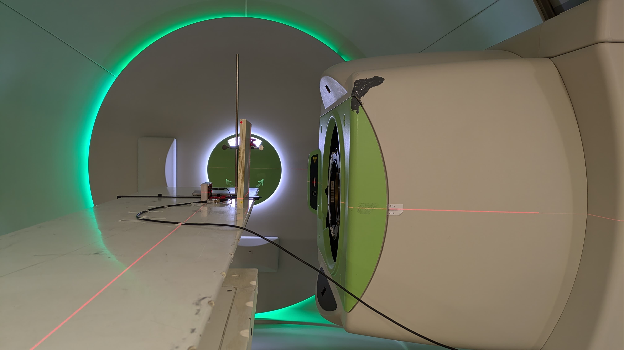
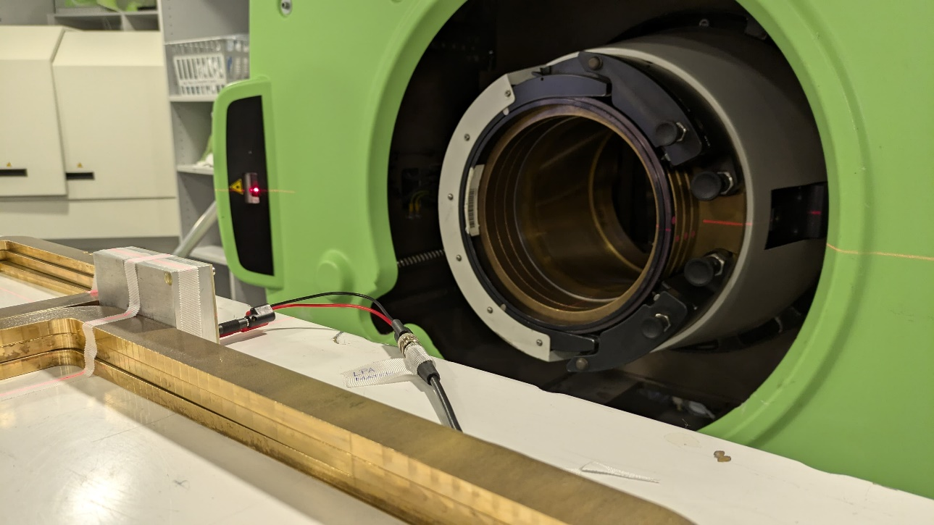
First Results on individual Diodes at WPE
Luisa Parschat
19.11.2024
Notes:
Foto ändern

Slide 2
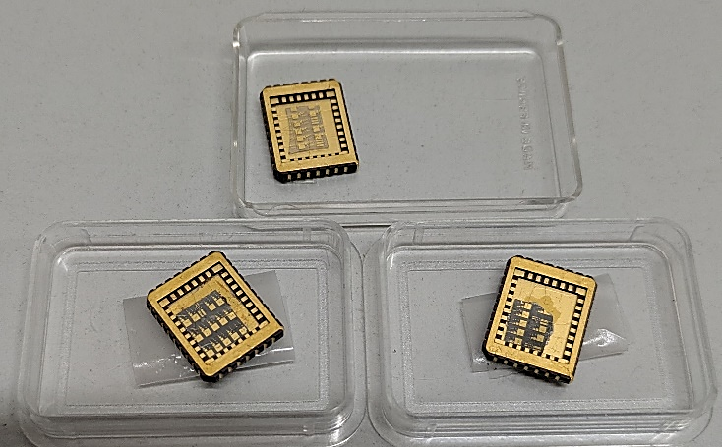
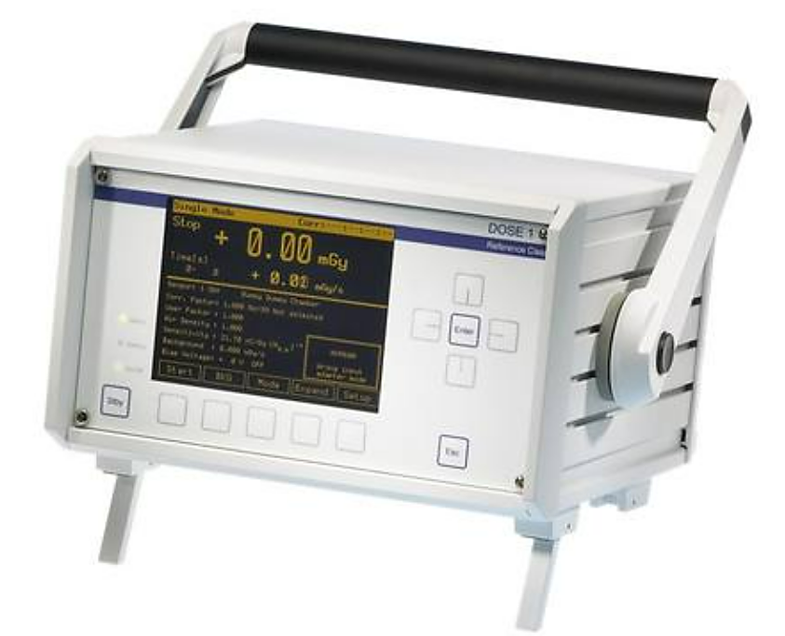
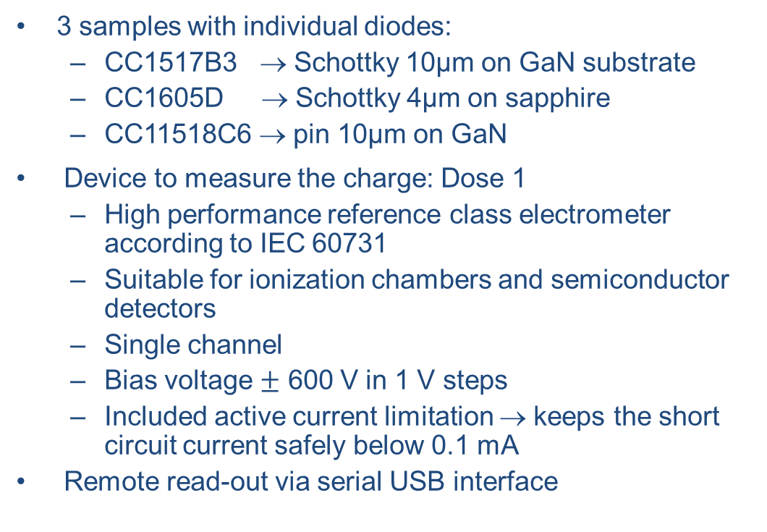
Materials & Methods
3 samples with individual diodes:
CC1517B3 → Schottky 10µm on GaN substrate
CC1605D → Schottky 4µm on sapphire
CC11518C6 → pin 10µm on GaN
Device to measure the charge: Dose 1
High performance reference class electrometer according to IEC 60731
Suitable for ionization chambers and semiconductor detectors
Single channel
Bias voltage $±$ 600 V in 1 V steps
Included active current limitation → keeps the short circuit current safely below 0.1 mA
Remote read-out via serial USB interface

Slide 3
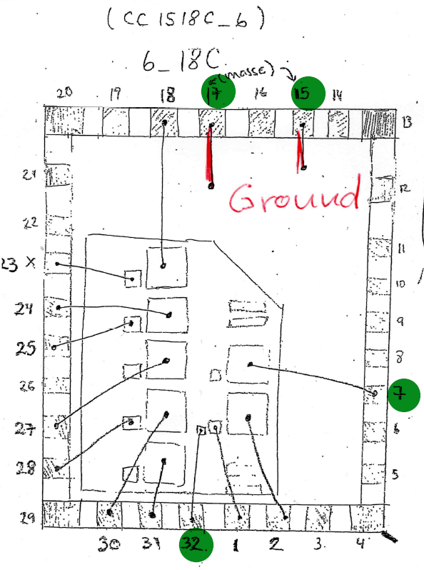
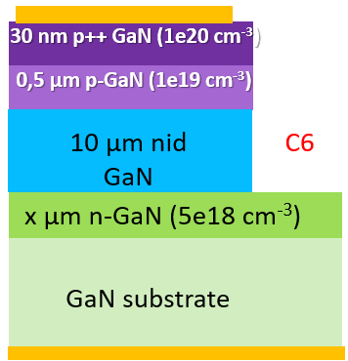
CC1518C_6 (6_18C)
Pin diode
10 µm GaN on GaN substrate
Ground 15 and 17
Electrically connected Diode 7 and 32
Irradiation with
E = 100 MeV
Field size: 2,5cm x 2,5cm
300 MU
Connections | Charge [nC] | Edge length
7 | 7,5 | 800 µm
32 | 11,6 | 200 µm
- electrically connected

Slide 4
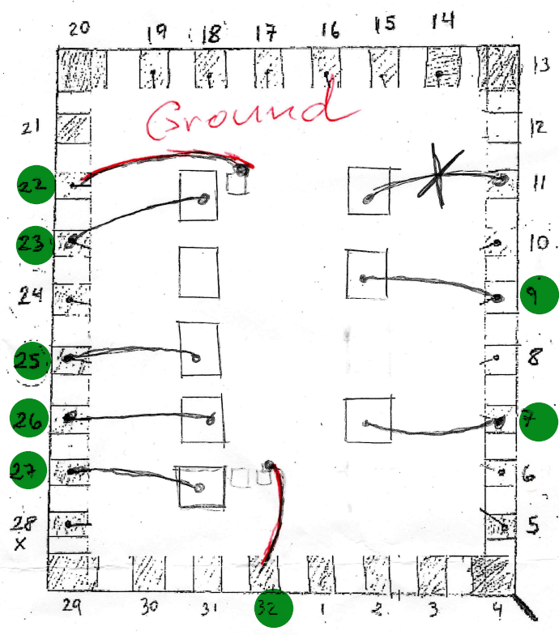
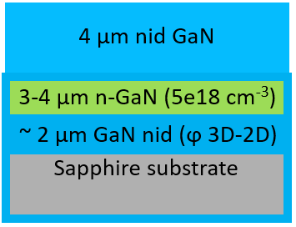
CC-1605D-4μm
Schottky diode 4µm on Sapphire
Edge length 800µm (for each diode)
Ground 22 and 23
Irradiation with
E = 100 MeV
Field size: 2,5cm x 2,5cm
300 MU
→ active current limitation, i.e. no
signal acquisition possible
Connections | Charge [nC]
7 | -
9 | 41,83
23 | -
25 | -
26 | -
27 | 4,804
- electrically connected

Slide 5
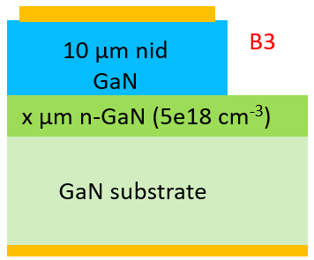
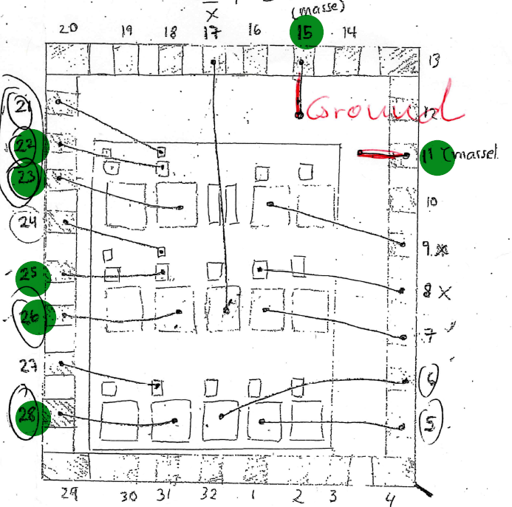
CC1517B_3 (3_17B)
Schottky diode 10µm on GaN substrate
Ground 11 and 15
Irradiation with
E = 100 MeV
Field size: 2,5cm x 2,5cm
300 MU
→ value too high
Connections | Charge [nC] | Edge length
23 | 5,687 | 800 µm
26 | 4,993 | 800 µm
22 | 3,363 | 300 µm
25 | 3,923 | 300 µm
28 | 101,5 | 800 µm
- electrically connected

Slide 6
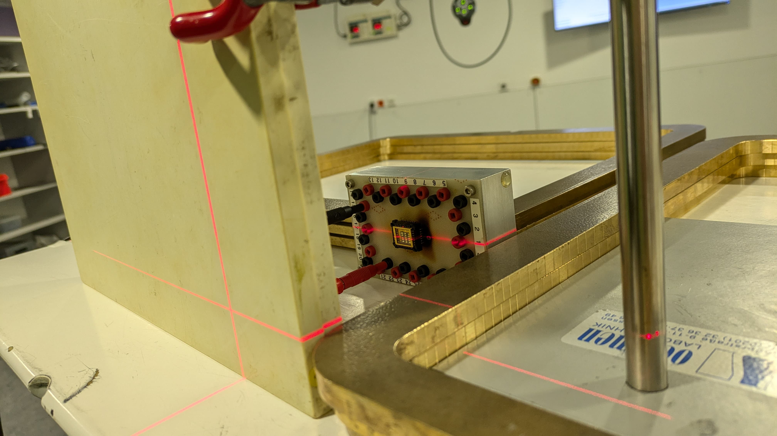
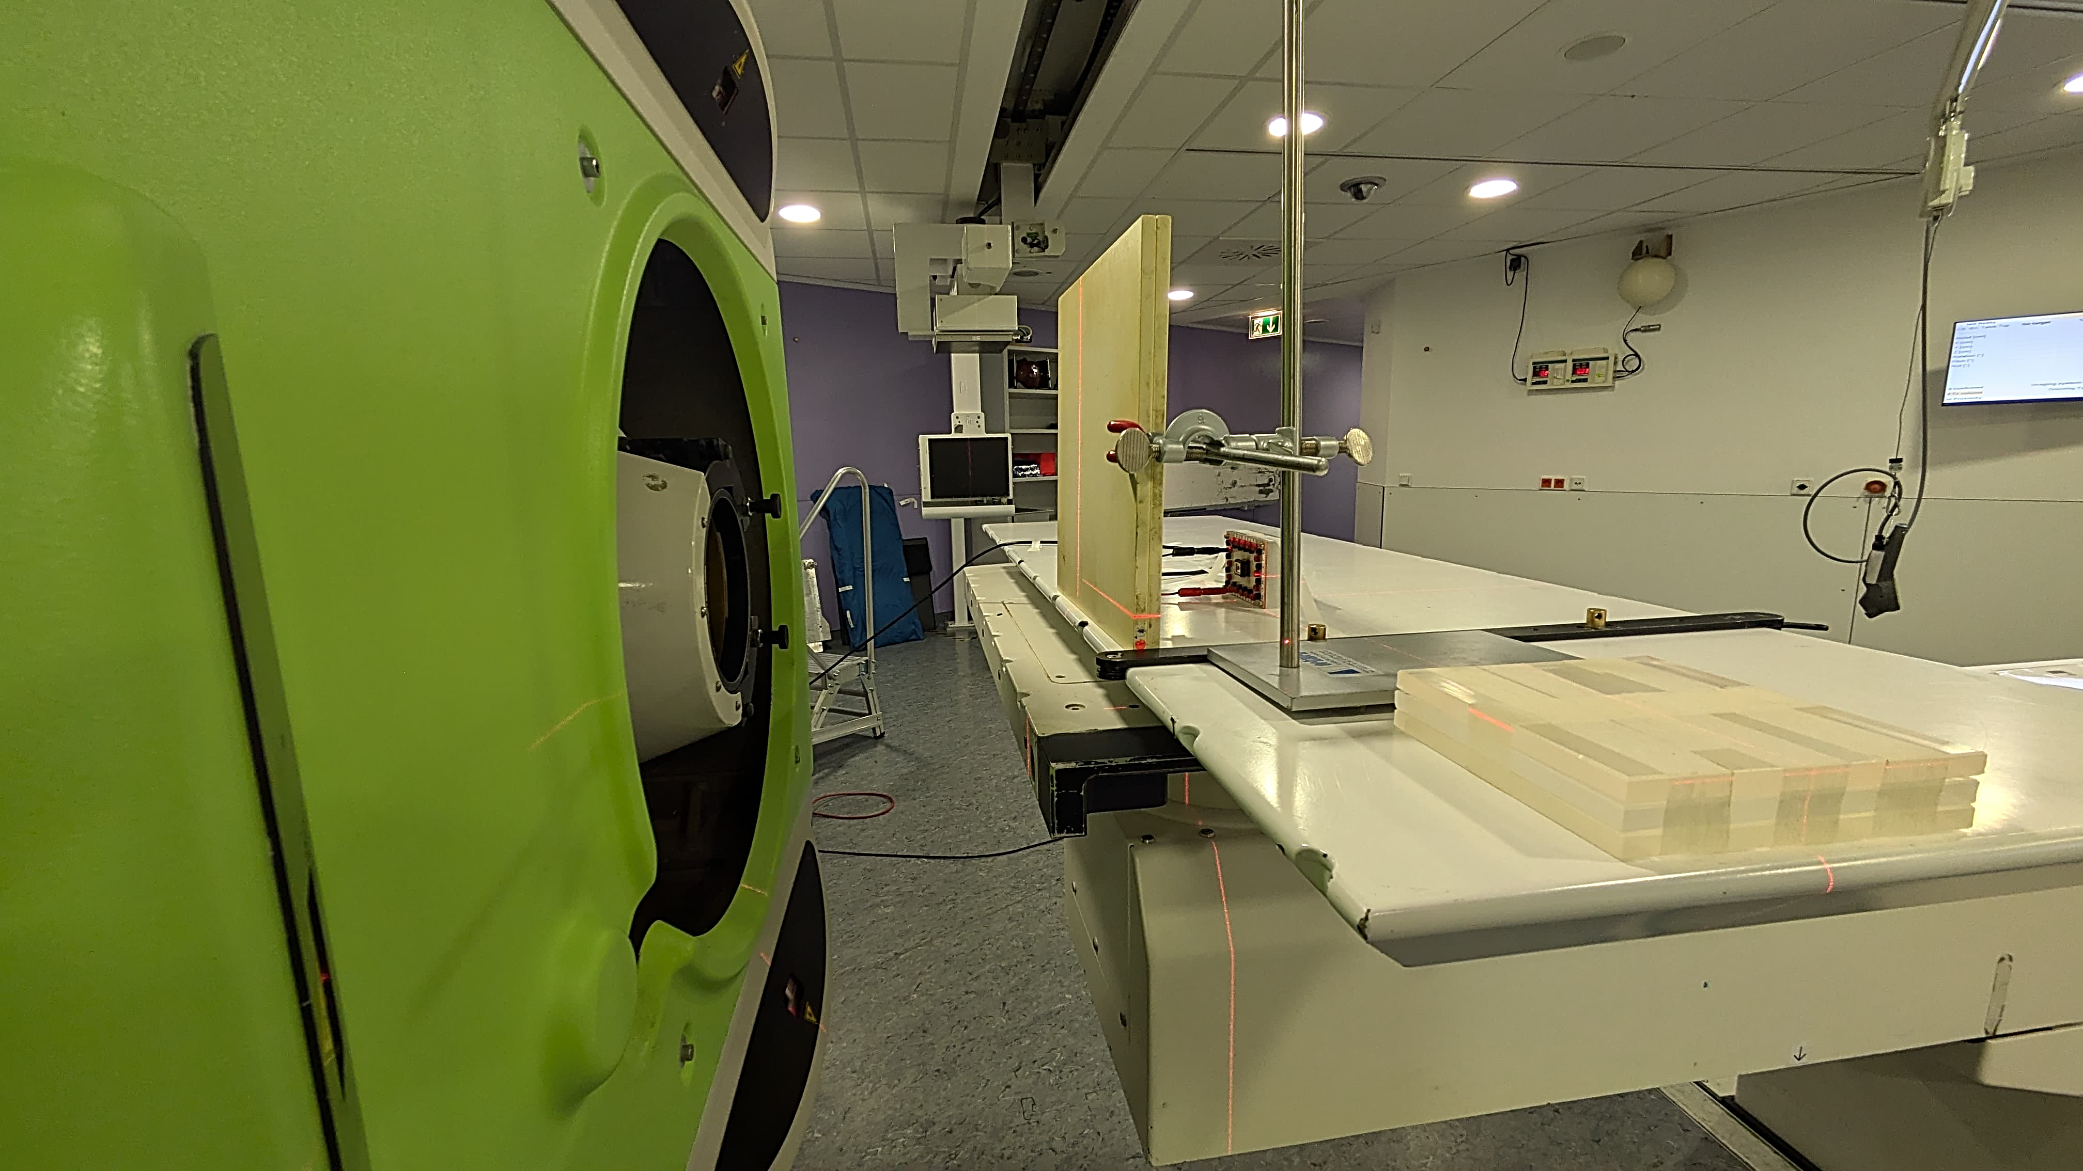
Measurement Setup
4 Diodes of CC1517B3
Dose 1
Reverse bias: -2 V and -4 V
Setup
Perpendicular to the beam
Sample in isocenter
2 cm RW3
Irradiation with
2,5 x 2,5 cm field
Energy: 100 MeV
Variation of Monitor Units:
Repetition of each dose step: 10 times
MU/Spot | 0.02 | 0.025 | 0.1 | 1 | 3 | 7 | 10 | 12
Dose [Gy] | 0.035 | 0.044 | 0.177 | 1.77 | 5.29 | 12.36 | 17.7 | 21.2
Notes:
Hier foto ändern

Slide 7
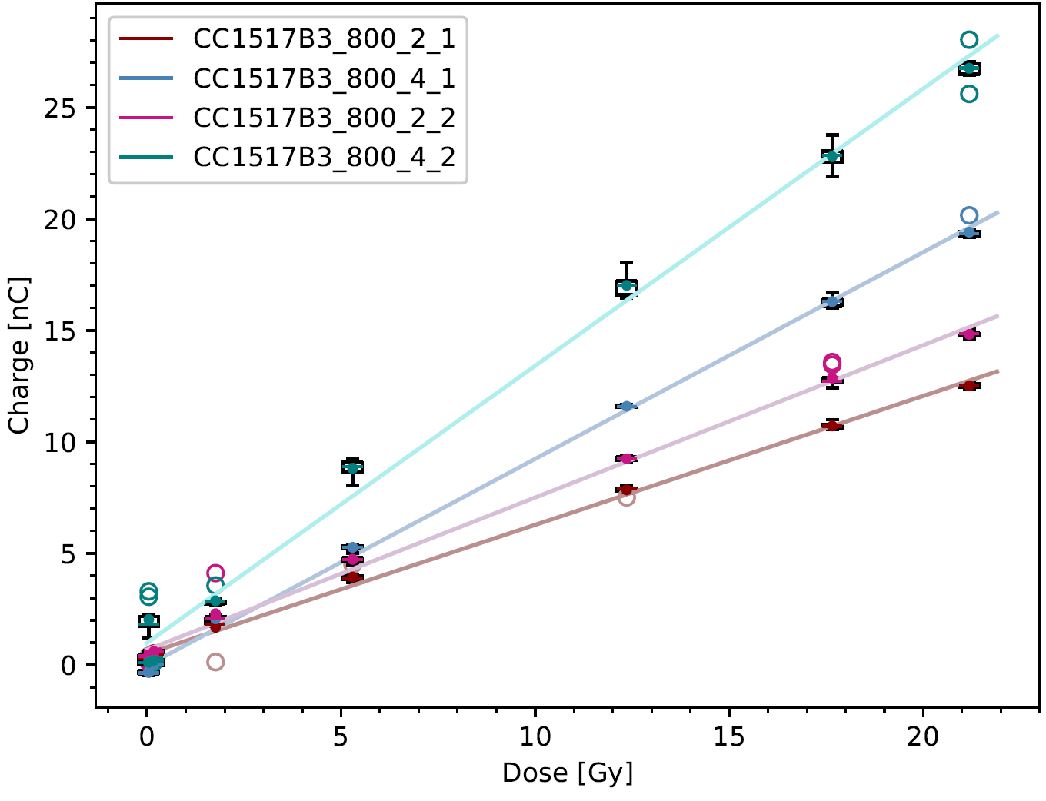
Results: Linearity
Fig. shows response of two 800µm diodes
Blue curves: Bias voltage of -4 V
Red curves: Bias voltage of -2 V
Determined R² shows that all diodes have good linearity.
Diode | Linear Regression | R²
CC1517B3_800_2_1 | y = 0.57814x +0.5012 | 0.998
CC1517B3_800_4_1 | y = 0.92721x -0.0315 | 0.998
CC1517B3_800_2_2 | y = 0.68315x +0.6759 | 0.997
CC1517B3_800_4_2 | y = 1.24281x +0.9878 | 0.993
Notes:
Doppelt logarithmisch -> folie dublizieren

Slide 8
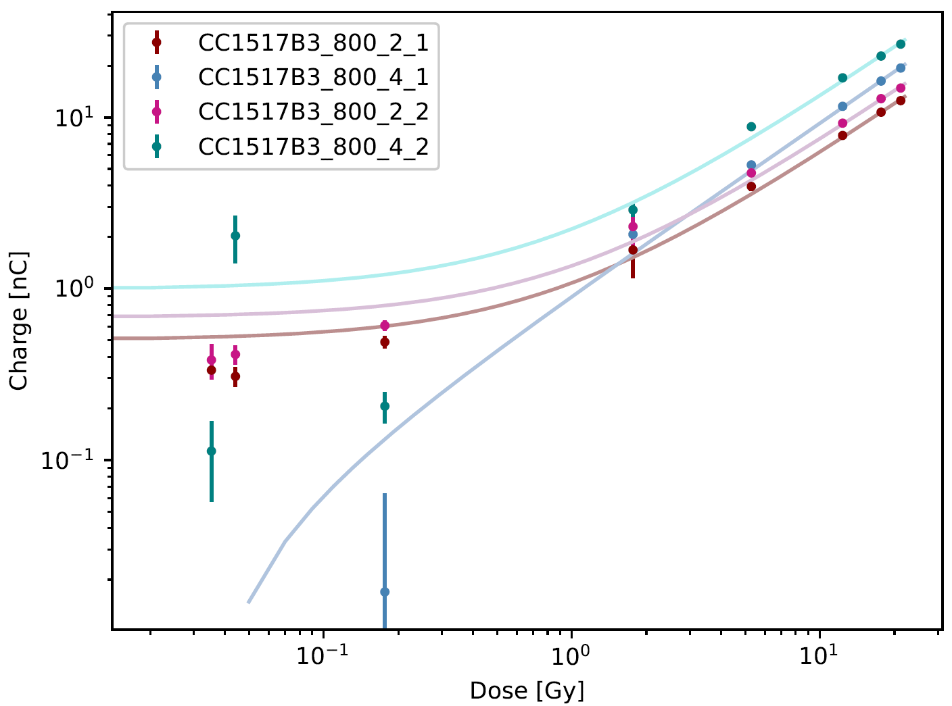
Results: Linearity
Fig. shows response of two 800µm diodes
Blue curves: Bias voltage of -4 V
Red curves: Bias voltage of -2 V
Determined R² shows that all diodes have good linearity.
Diode | Linear Regression | R²
CC1517B3_800_2_1 | y = 0.57814x +0.5012 | 0.998
CC1517B3_800_4_1 | y = 0.92721x -0.0315 | 0.998
CC1517B3_800_2_2 | y = 0.68315x +0.6759 | 0.997
CC1517B3_800_4_2 | y = 1.24281x +0.9878 | 0.993
Notes:
Doppelt logarithmisch -> folie dublizieren

Slide 9
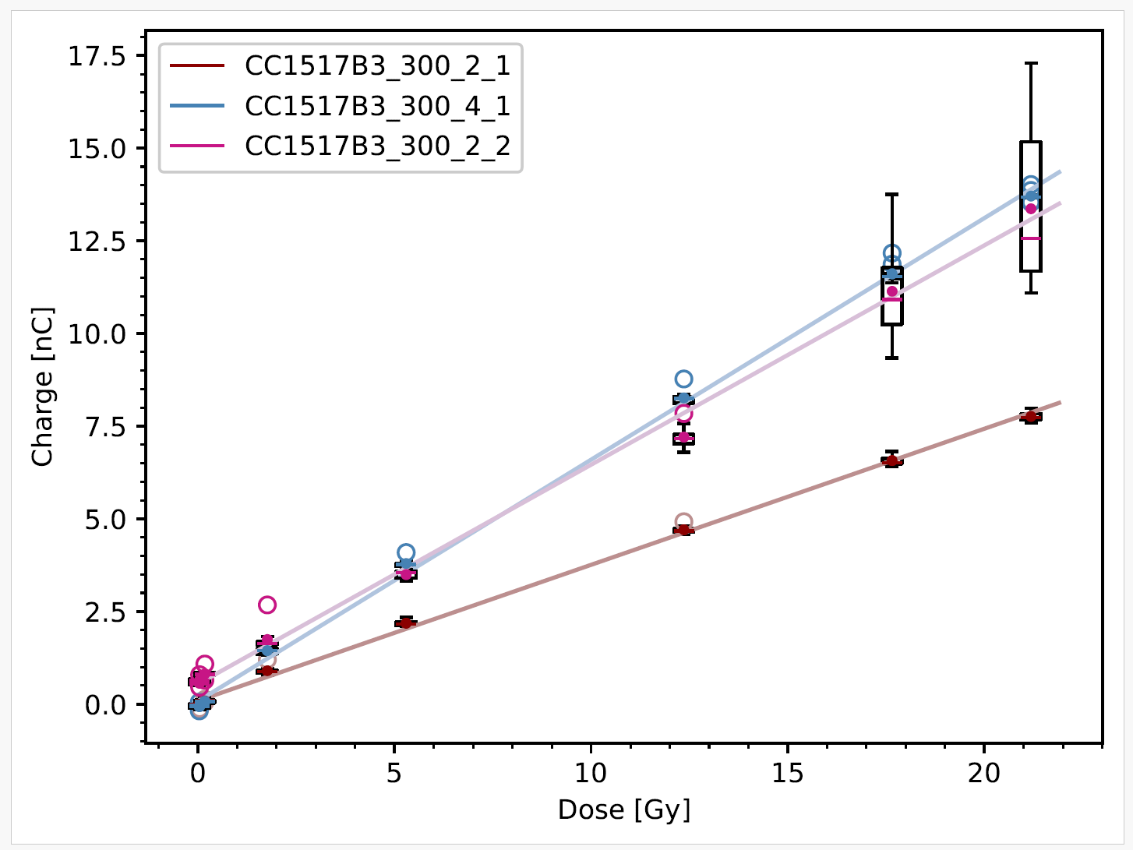
Results: Linearity
Fig. shows response of two 300µm diodes
Blue curve → Bias voltage of -4 V (Diode1)
Red curves: Bias voltage of -2 V
Determined R² shows that all diodes have good linearity.
Diode | Linear Regression | R²
CC1517B3_300_2_1 | y = 0.36717x +0.0860 | 0.999
CC1517B3_300_4_1 | y = 0.65187x +0.0763 | 0.999
CC1517B3_300_2_2 | y = 0.59185x +0.5412 | 0.997
Notes:
Begründung für außreißer
Abgleich mit fehlern beon strahlen
->
Länger messzeit
Nächst folie aktive detektordicke
Geradegleichungen und r^2

Slide 10
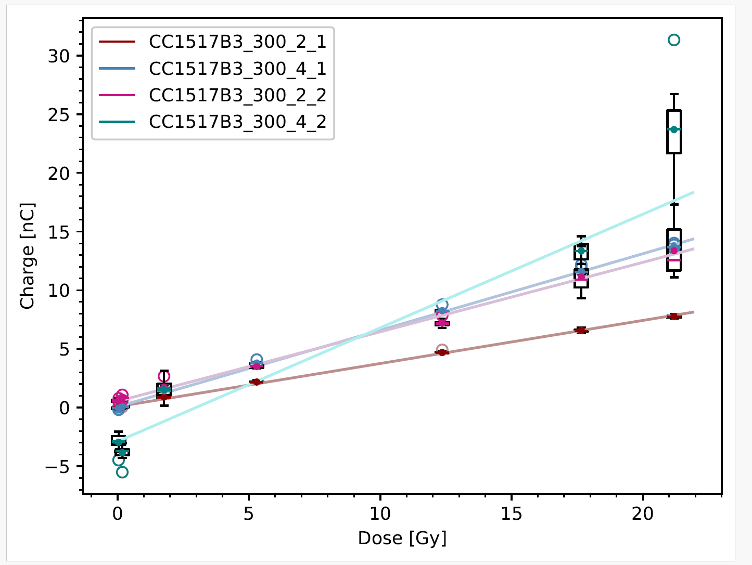
Results: Linearity
Fig. shows response of two 300µm diodes
Blue curve → Bias voltage of -4 V (Diode1)
Red curves: Bias voltage of -2 V
Determined R² shows that all diodes have good linearity.
Diode | Linear Regression | R²
CC1517B3_300_2_1 | y = 0.36717x +0.0860 | 0.999
CC1517B3_300_4_1 | y = 0.65187x +0.0763 | 0.999
CC1517B3_300_2_2 | y = 0.59185x +0.5412 | 0.997
Notes:
Begründung für außreißer
Abgleich mit fehlern beon strahlen
->
Länger messzeit
Nächst folie aktive detektordicke
Geradegleichungen und r^2

Slide 11
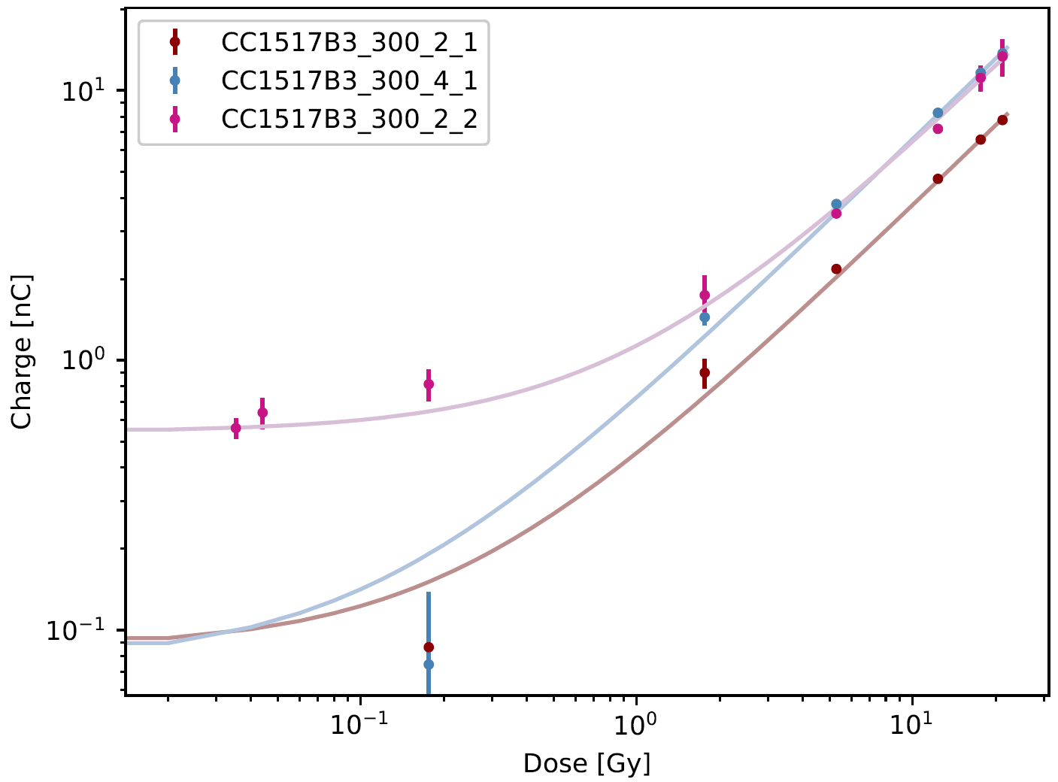
Results: Linearity
Fig. shows response of two 300µm diodes
Blue curve → Bias voltage of -4 V (Diode1)
Red curves: Bias voltage of -2 V
Determined R² shows that all diodes have good linearity.
Diode | Linear Regression | R²
CC1517B3_300_2_1 | y = 0.36717x +0.0860 | 0.999
CC1517B3_300_4_1 | y = 0.65187x +0.0763 | 0.999
CC1517B3_300_2_2 | y = 0.59185x +0.5412 | 0.997
Notes:
Begründung für außreißer
Abgleich mit fehlern beon strahlen
->
Länger messzeit
Nächst folie aktive detektordicke
Geradegleichungen und r^2

Slide 12
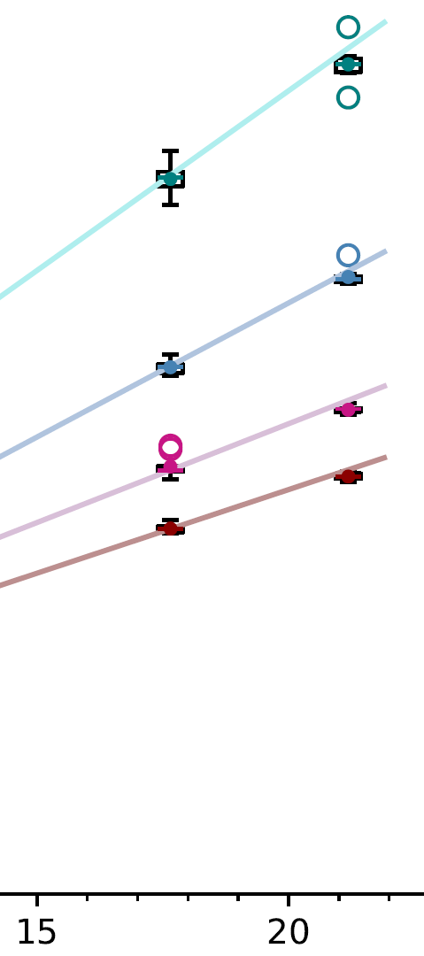
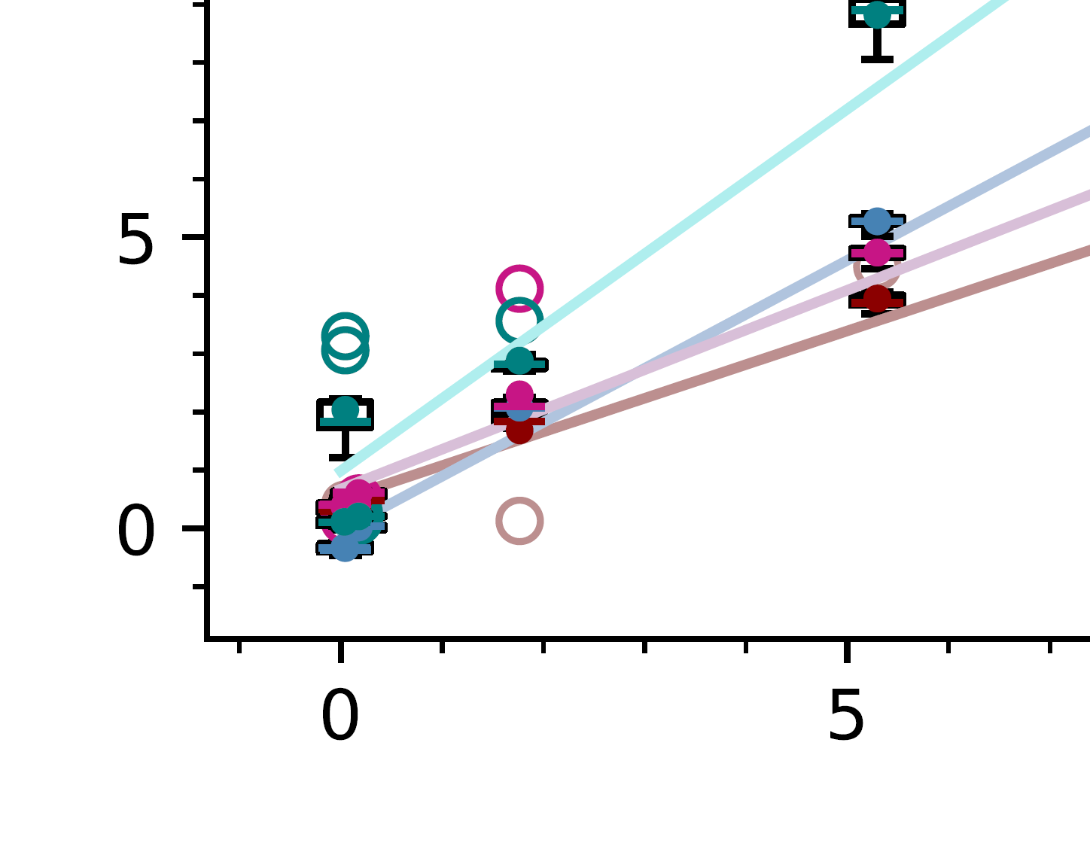
Possible reasons for Outliers
Outliers occur when diode has not been irradiated for a certain period of time
Assumption: Observable for time intervals >5min
Paused Beam → Time of measurement was 7s longer
Leads to a higher value
Explanation ???
→ time dependent variable
sensitivity,
leakage current?
Negative charges measured in low-dose areas
Explanation ???
→ Leakage current,
polarization or noise?

Slide 13
Rough Estimate of the Active Detector Thickness
Purpose: Estimate the active thickness of the detectors from
Measured charge
Total number of protons
Number of generated electron-hole pairs per proton
Stopping power of GaN (SRIM)
Red numbers include negative charges and are therefore not reliable.
CC1517B3_300_2_2 is the defective diode, which is also reflected in the estimate of the active detector thickness .
Schottky diode CC1517B3 with an edge length of 800µm
 | full dose range | 0.177 to 21.2 Gy | 1.77 to 21.2 Gy
CC1517B3_800_2_1 | 8.75 µm | 3.32 µm | 2.18 µm
CC1517B3_800_2_2 | 10.8 µm | 4.02 µm | 2.70 µm
CC1517B3_800_4_1 | -4.61 µm | 2.59 µm | 3.05 µm
CC1517B3_800_4_2 | 22.2 µm | 4.31 µm | 4.45 µm
Schottky diode CC1517B3 with an edge length of 300µm
 | full dose range | 0.177 to 21.2 Gy | 1.77 to 21.2 Gy
CC1517B3_300_2_1 | 4.91 µm | 9.24 µm | 8.94 µm
CC1517B3_300_2_2 | 88.6 µm | 26.9 µm | 13.9 µm
CC1517B3_300_4_1 | 1.31 µm | 1.43 µm | 15.4 µm
Diode_Size_BiasVoltage_Number

Slide 14
Further Actions
Wire bonding to fix non-working diodes → help from Bochum?
Or new samples?
Experiments regarding the time response of the diodes
Investigate the influence of variable beam current and timing (Repainting)

